Slide 1
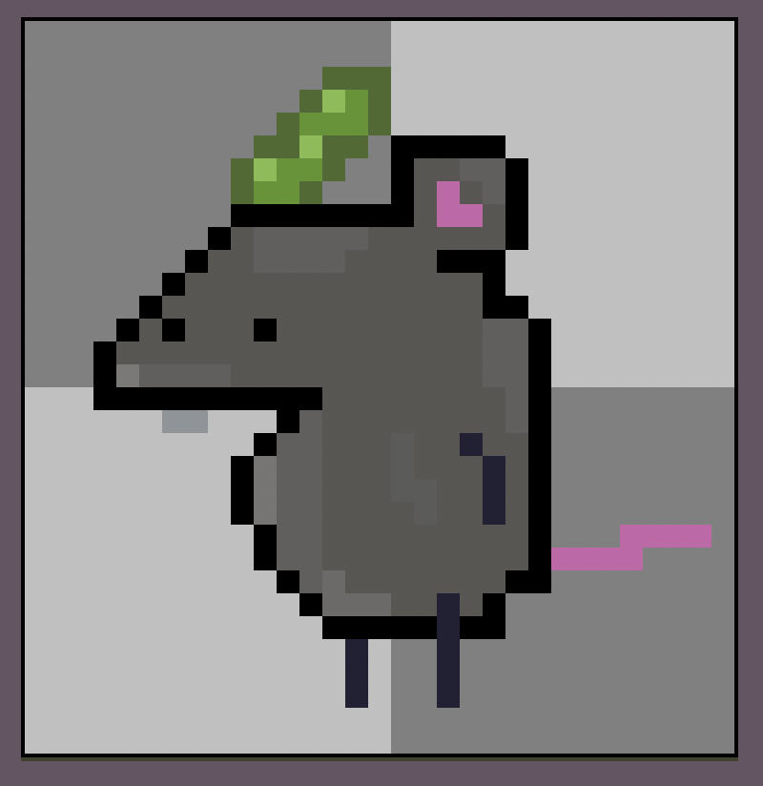
Pestis
Harvey, Murray, Shayaan, Vinh, Chongsheng, Ani
Weekly review – 20/01/2025

Slide 2
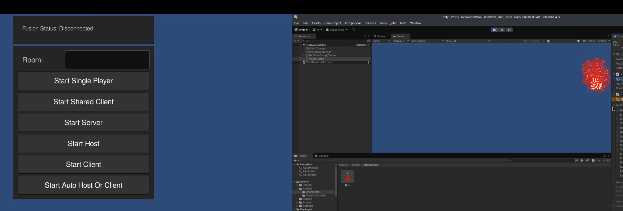
17/01 and before
Created skeleton unity model
Used Photon fusion to create networking aspects
Added population model for rat hordes

Slide 3
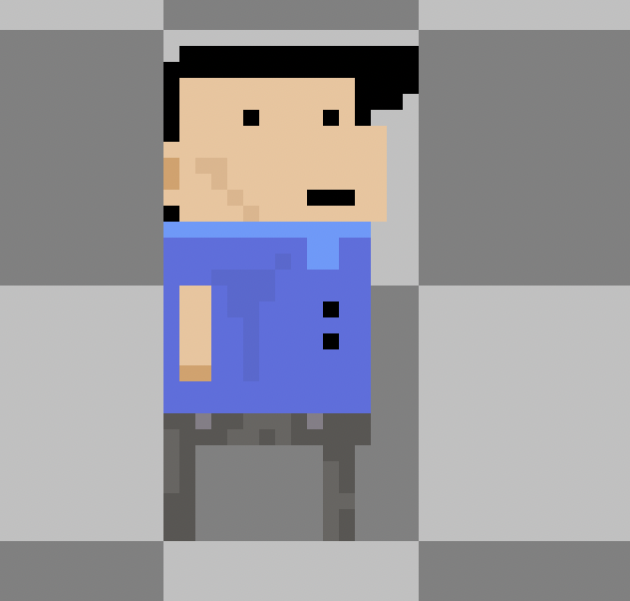
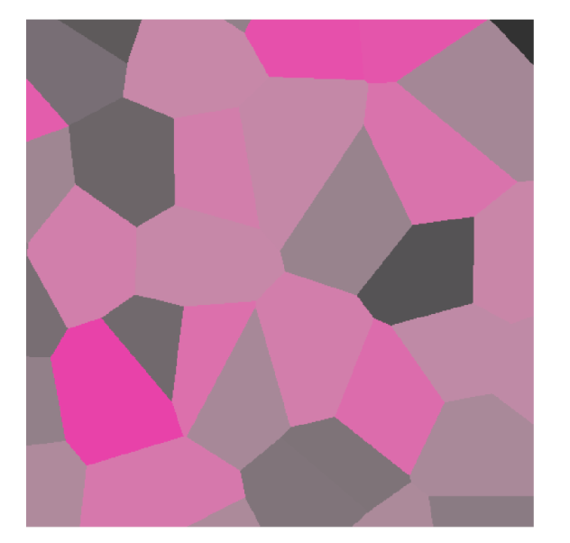
17/01 and before cont
Drew up some concepts and created a few simple assets
Procedurally generate a map using voronoi techniques
Horde movement and health aspect

Slide 4
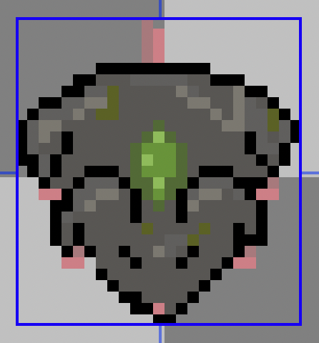
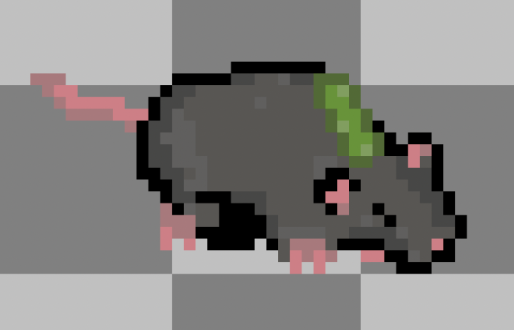
18/01
Created UI framework and ideas
More character designs
Added correct enemy interaction to horde selection controls

Slide 5
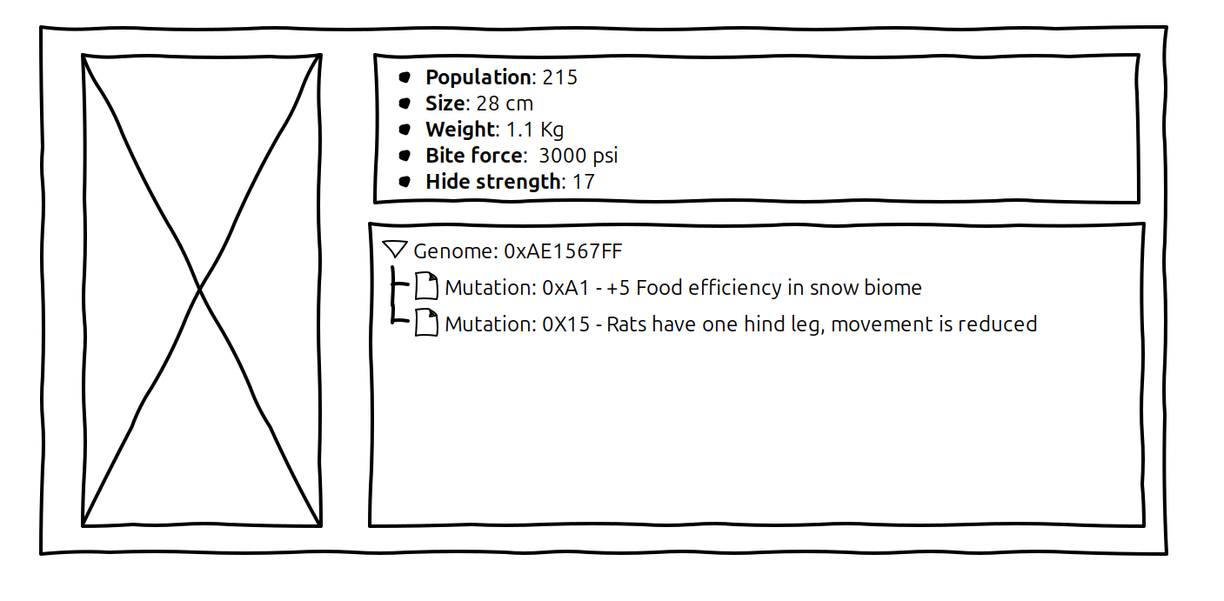
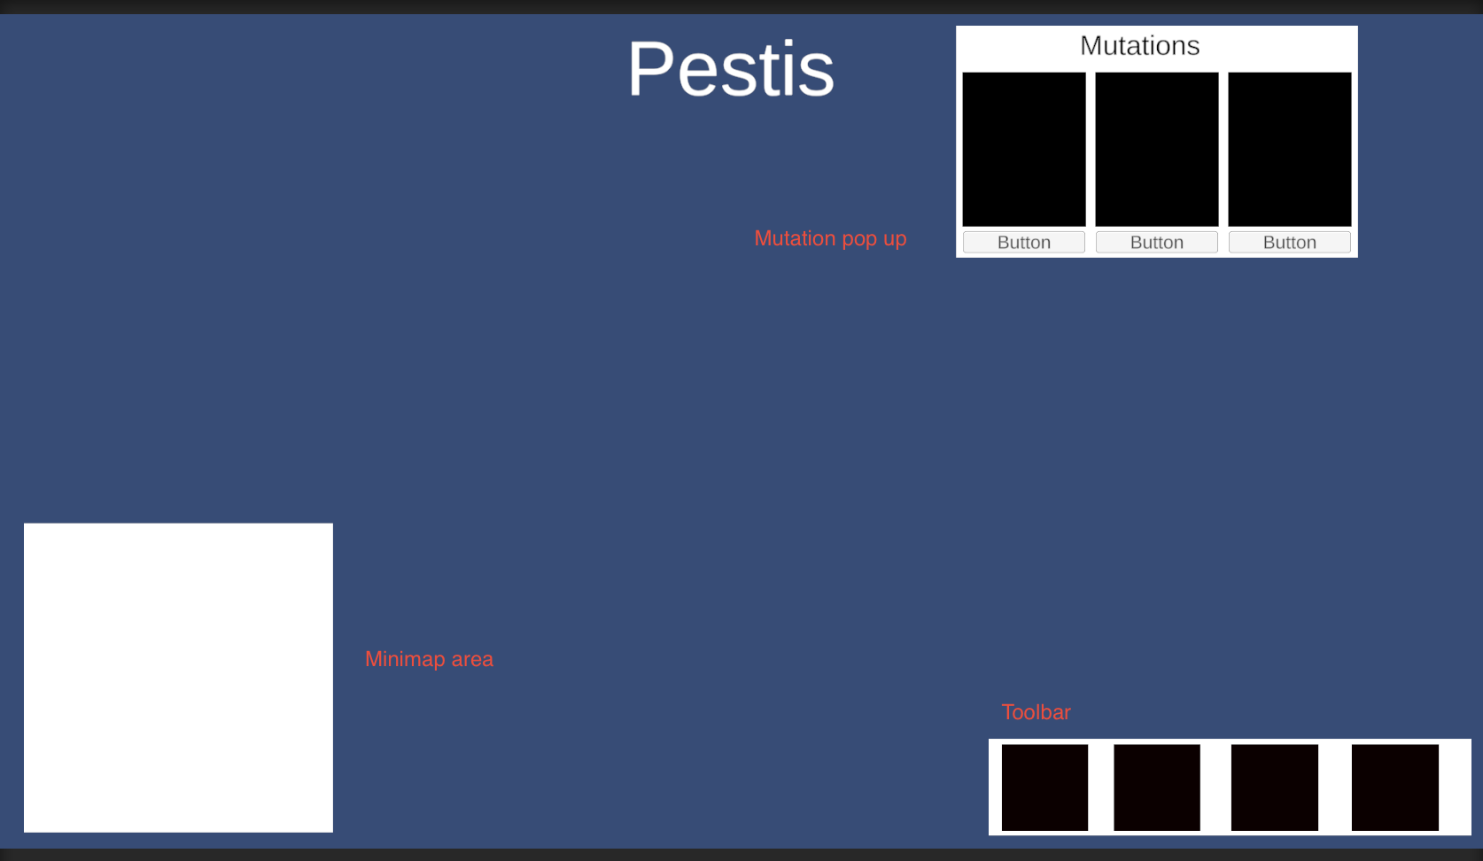
19/01
Enable rat rotation when moving in a different direction
Make a nicer 'rat flow' within the horde
More menu sketches

Slide 6
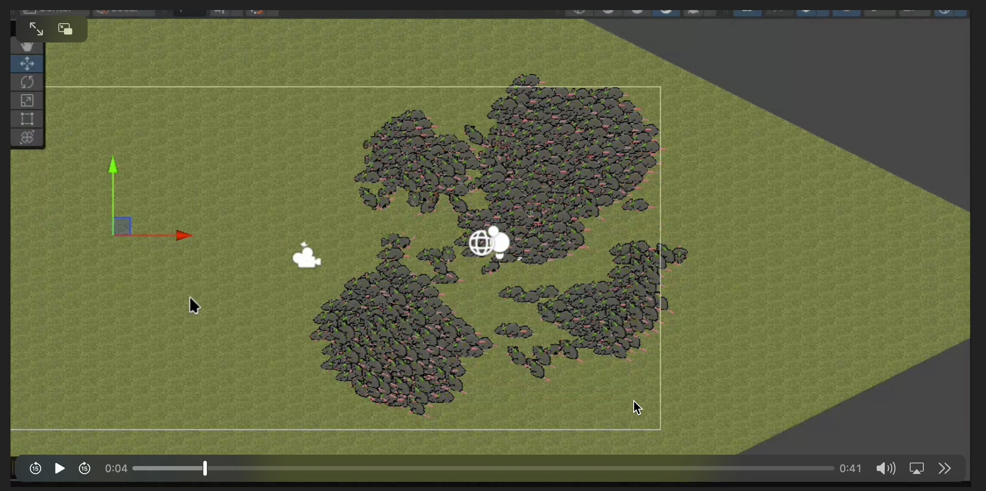

Slide 7
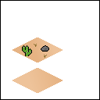
20/01
Start designing POIs for the maps
Improve horde selection controls
Added camera controls
Implementing UI into skeleton
Design UI graphics

Slide 8
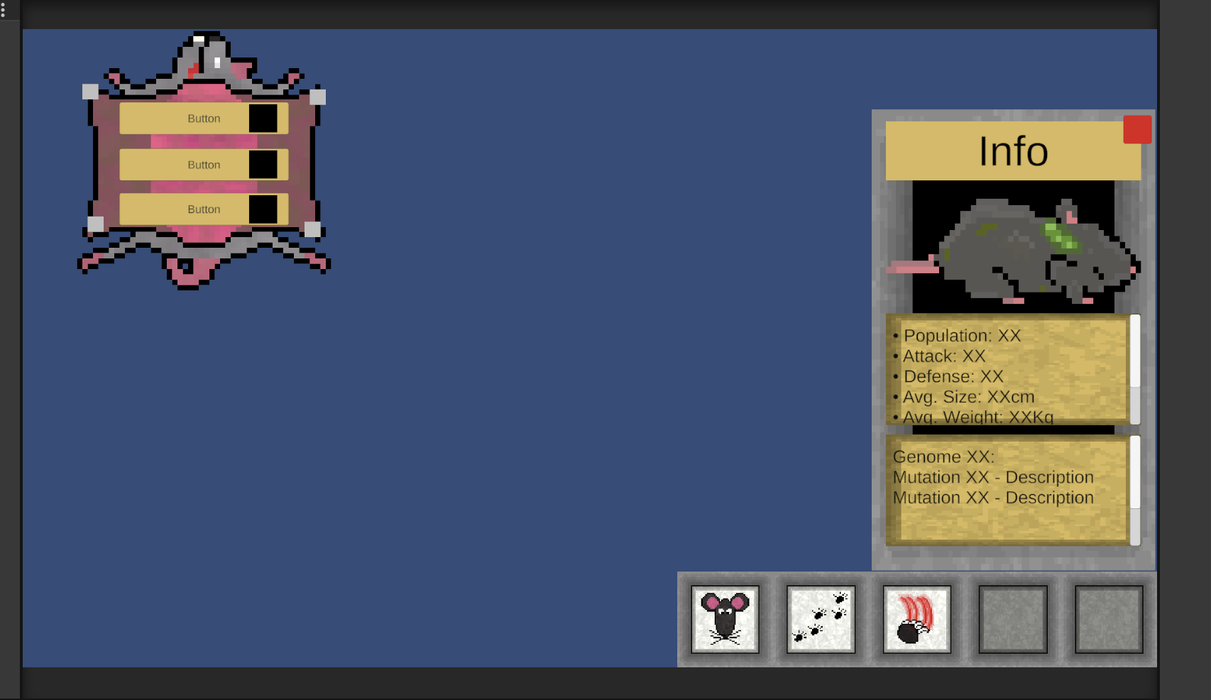
21/01
Continue UI design
Initial combat implementation
Added dev tool for horde inspection

Slide 9
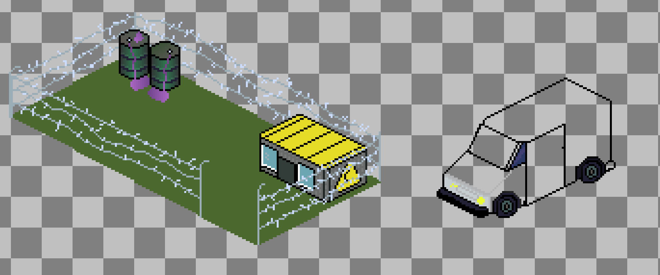
22/01
Continue making combat work over network
Figure out procedural generation specifically for our game
More design
Started writing code for different biome classes

